Slide 1

DEEPSEA implementation in IGAP variants
Pradeep Varathan

Slide 2
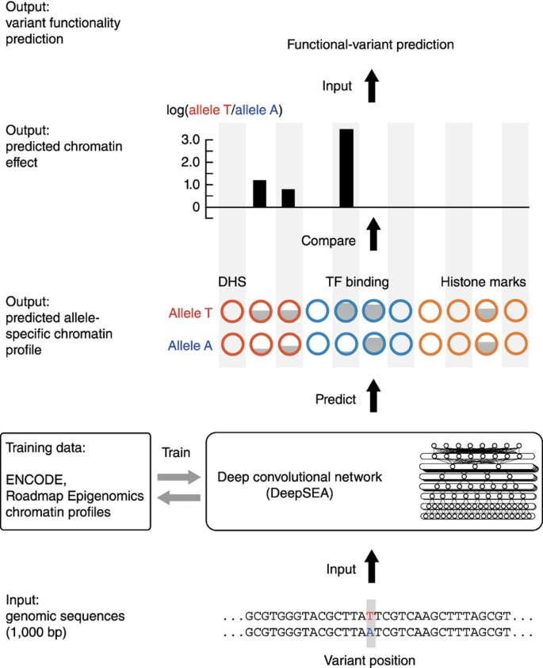
DeepSEA
Uses three convolutional layers with a ReLu activation function and a maxpooling layer to reduce the dimensionality further, while the linear neural network at the final layer completes the reduction to fit the 919 chromatin types from different cell types as the output.

Slide 3

IGAP – Dataset Used
IGAP (International Genomics of Alzheimer's Project) summary analysis from it’s GWAS performed on cohorts of Alzheimer's disease patients.
IGAP used genotyped and imputed data on 7,055,881 single nucleotide polymorphisms (SNPs) to meta-analyse four previously-published GWAS datasets consisting of 17,008 Alzheimer's disease cases and 37,154 controls

Slide 4
IGAP Variants
Obtained the IGAP GWAS summary statistics
Filtered the variants that have p-value < 0.05
Converted the file format into the tab separated format
File found in : Data/SNPs_Thres_0.05

Slide 5
Obtaining sequences
Using the BioPython package’s Entrez module to get sequences from NCBI
Used the API KEY to make the process faster and obtain 53000 sequences
Has a separate function to pack the sequences into pickle file

Slide 6
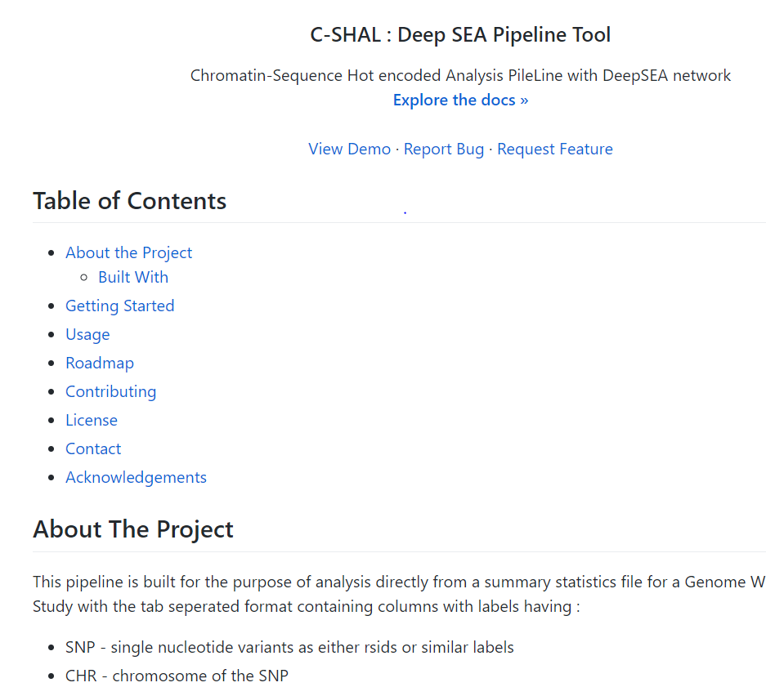
C-SHAL
https://github.com/PradoVarathan/C-SHAL-DeepSEA

Slide 7
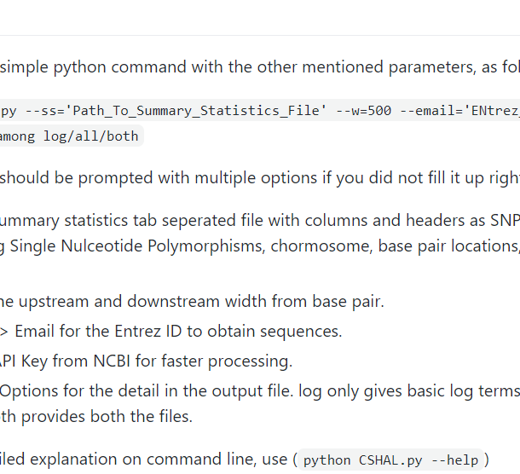
Process for future use

Slide 8
Results of IGAP
8988T_DNase is the only modification seen. Human pancreas adenocarcinoma (PA-TU-8988T), "established in 1985 from the liver metastasis of a primary pancreatic adenocarcinoma from a 64-year-old woman; sister cell line of PA-TU-8988S"
SNAP25-AS1, MAST4,ICA1L, MTUS2,KAZN, SEMA3, DLGAP1, ADAM12, RAB3IL1, DCC,ALK
RS ID | Log differential
rs112209025 | 7.627517
rs6802980 | 7.389298
rs144630409 | 7.190806
rs4962329 | 7.16893
rs4963275 | 6.921384
rs4917711 | 6.889097
rs34452734 | 6.682741

Slide 9
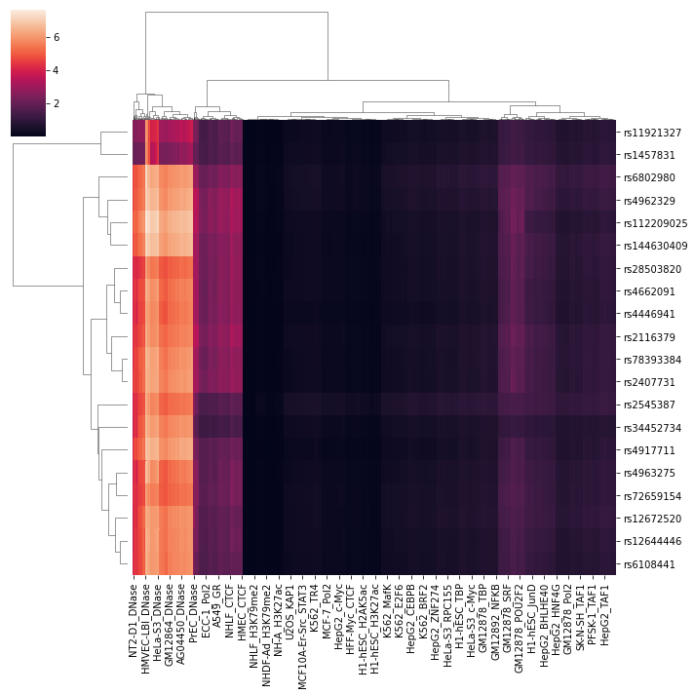
Cluster map of top 20 log changes variants

Slide 10
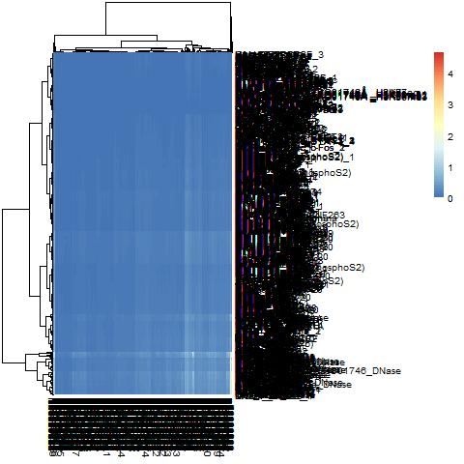
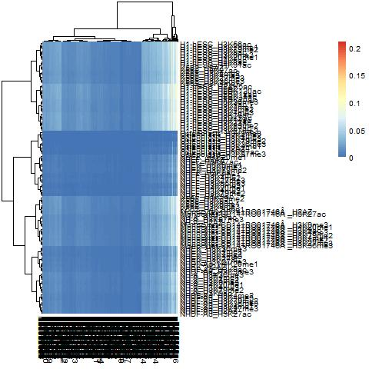
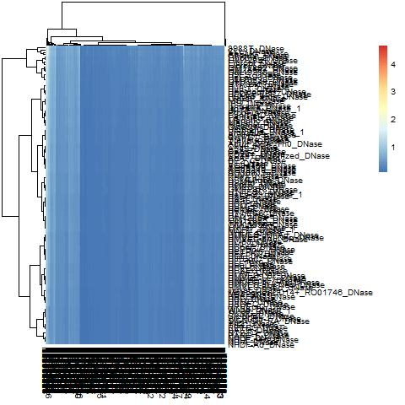
Comparison of all 3 types

Slide 11
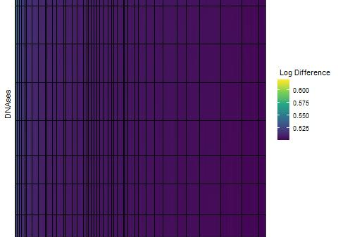
DNAse

Slide 12
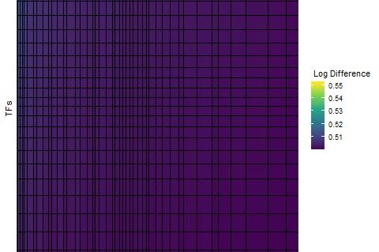
Transcription Factors

Slide 13
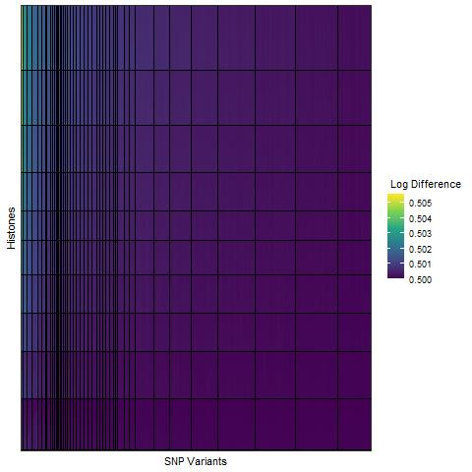
Histones

Slide 14
Cluster 1 of DNAses
4 main DNAses found – 8988T Dnase, AoSMC Dnase, CLL_Dnase and Chorion Dnase
Out of these, 644 SNP variants were recorded to contribute in large changes in the DNAse
Rs10520163 has been very well studied under Schizophrenia and Alzheimers, and is also present in the top snps of this cluster

